Slide 1
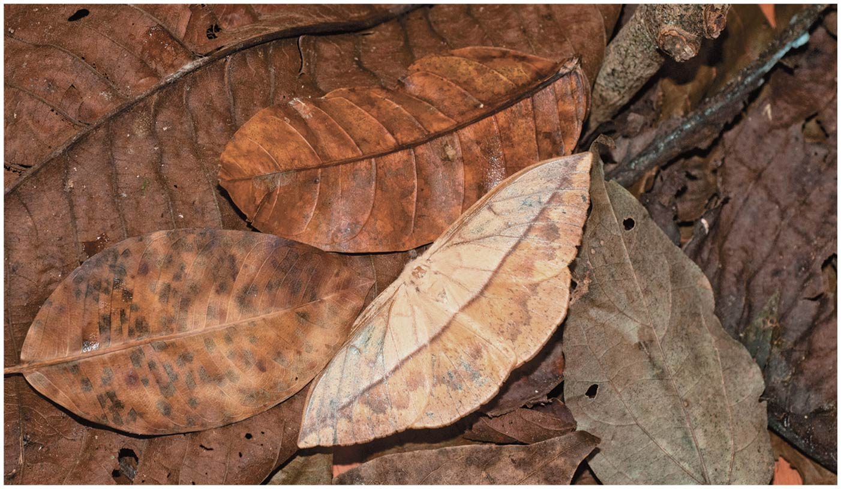
Introduction
LSU BIOL 1202
General Biology II Lecture
CHAPTER 22
Descent with Modification, A Darwinian View of Life
Dr. Adam Hrincevich
Notes:
Figure 22.1 How is its resemblance to a fallen leaf helpful to this moth?

Slide 2
CH 22 Learning Objectives
Compare Darwin's concept of descent with modification to the prevailing ideas of his time.
Explain how, over time, natural selection results in organisms' adaptation to their environment.
Use examples to show how evolution is supported by scientific evidence.
I would suggest completing the crossword puzzle to help you understand the terminology and correlate how the terms relate to topics covered in this chapter.

Slide 3
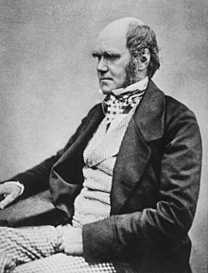
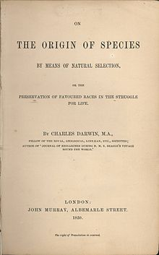
A Darwinian View of Life
A new era of biology began in 1859 when Charles Darwin published The Origin of Species, which focused on the
Darwin noted that current species are descendants of
Evolution can be defined by Darwin’s phrase
Evolution can be viewed as both a

Slide 4
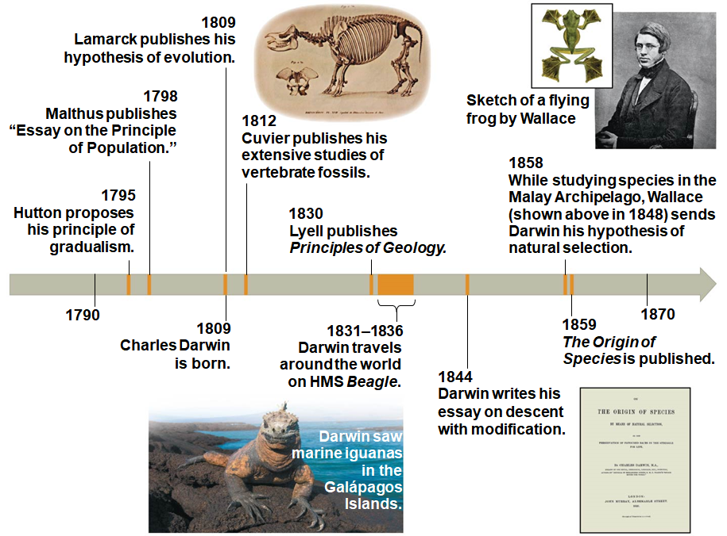
Concept 22.1: The Darwinian revolution challenged traditional views of a young Earth inhabited by unchanging species
Darwin’s ideas had
Notes:
Figure 22.2 The intellectual context of Darwin’s ideas

Slide 5
Scala Naturae and Classification of Species
The Greek philosopher Aristotle viewed species as fixed and
The Old Testament holds that species were individually
Carolus Linnaeus interpreted organismal adaptations as evidence that the Creator had designed each species for
Linnaeus was the founder of taxonomy, the branch of biology concerned with
“HANDS ON” ACTIVITY >>> Balls and coins
He developed the binomial format for

Slide 6
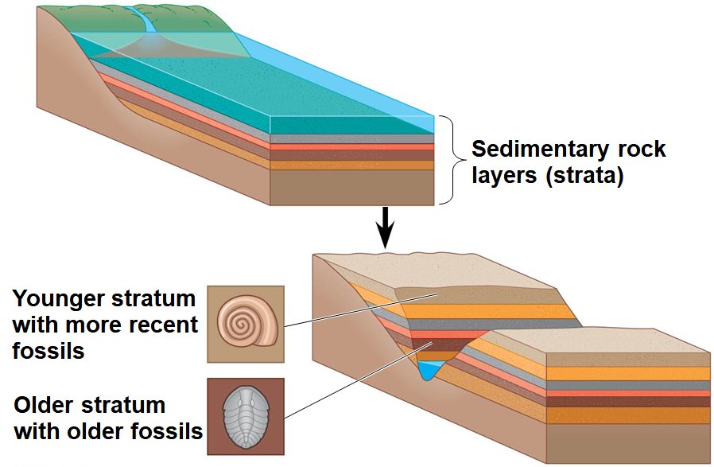
Ideas About Change over Time
The study of fossils helped to lay the
Fossils are remains or traces of organisms from the past, usually found in sedimentary rock, which appears in
Notes:
Figure 22.3 Formation of sedimentary strata with fossils

Slide 7
7
Paleontology, the study of fossils, was largely developed by
Cuvier speculated that the boundaries between strata represent
Geologists James Hutton & Charles Lyell thought that changes in Earth’s surface resulted from slow, steady actions still
This view strongly
French biologist Jean-Baptiste de Lamarck hypothesized that species evolve through use and disuse of
Proposed mechanisms are

Slide 8
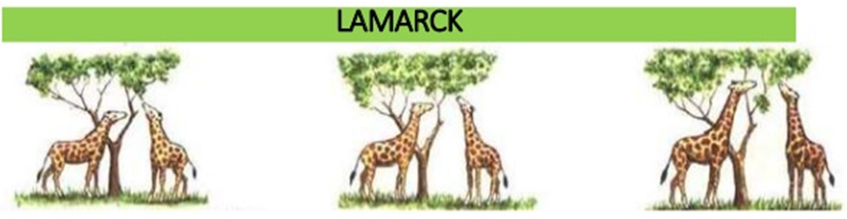
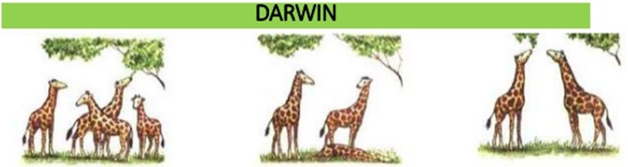
Lamarck vs. Darwin
Lamarck's theory held that species underwent changes in response to changes in their environment.
Darwin's theory was one of natural selection and survival of the fittest.

Slide 9
Concept 22.2: Descent with modification by natural selection explains the adaptations of organisms and the unity and diversity of life
Some doubt about the permanence of species
As a boy and into adulthood, Charles Darwin had a consuming
Darwin first studied medicine (unsuccessfully) and then theology at
After graduating, he took an unpaid position as naturalist and companion to Captain Robert Fitzroy for a five-year,

Slide 10
The Voyage of the Beagle
During his travels on the Beagle, Darwin collected specimens of
He observed that fossils resembled living species from the same region, and living species resembled
He experienced an earthquake in Chile and
Darwin was influenced by Lyell’s Principles of Geology and thought that Earth
He stopped at the Galápagos Islands and hypothesized that species from South America had colonized the Galápagos and

Slide 11
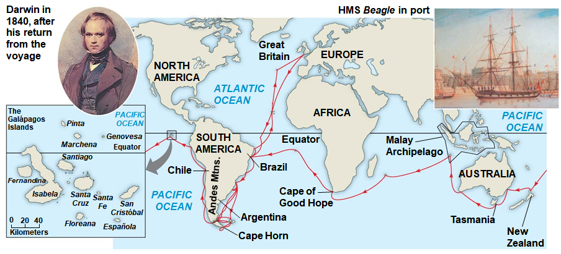
Figure 22.5
Notes:
Figure 22.5 The voyage of HMS Beagle (December 1831–October 1836)

Slide 12
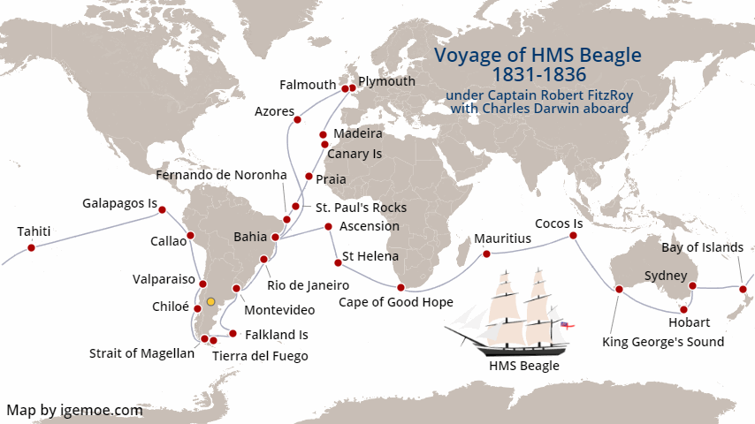
Notes:
Voyage of the HMS Beagle

Slide 13
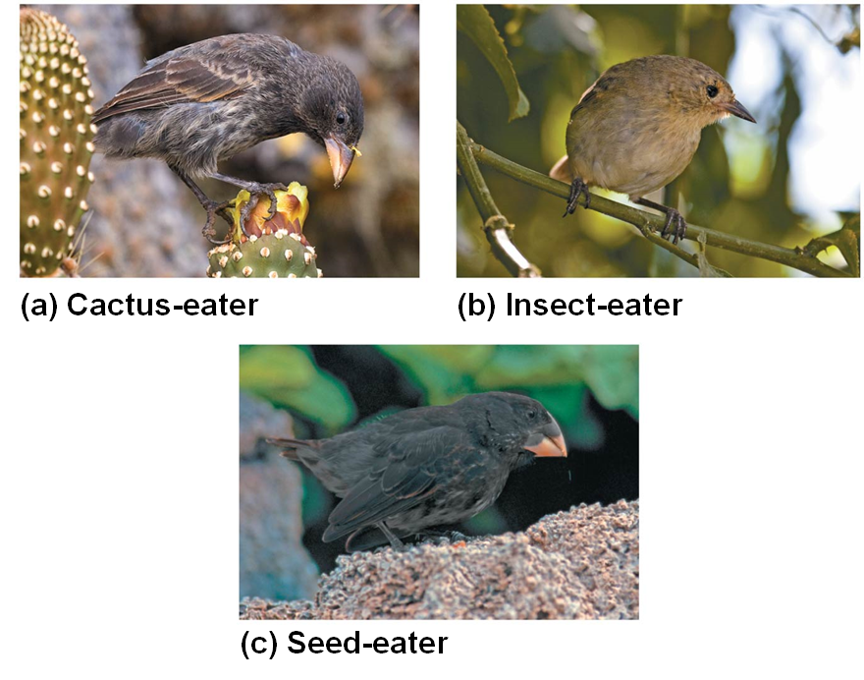
Darwin’s Focus on Adaptation
In reassessing his observations, Darwin perceived adaptation to the environment and the
From studies made years after Darwin’s voyage, biologists have concluded that
Notes:
Figure 22.6 Three examples of beak variation in Galápagos finches

Slide 14
13
In 1844, Darwin wrote an essay on natural selection as the mechanism of
Natural selection is a process in which individuals with favorable inherited traits are
In June 1858, Darwin received a manuscript from Alfred Russel Wallace, who had developed a theory of
Darwin quickly finished The Origin of Species and

Slide 15
Ideas from The Origin of Species
Darwin explained three broad observations:

Slide 16
Descent with Modification
Darwin never used the word
The phrase descent with modification summarized Darwin’s
The phrase refers to the view that all organisms are related through descent from an
In the Darwinian view, the history of life is like a tree with branches
Darwin reasoned that large morphological gaps between related groups could be explained by this

Slide 17
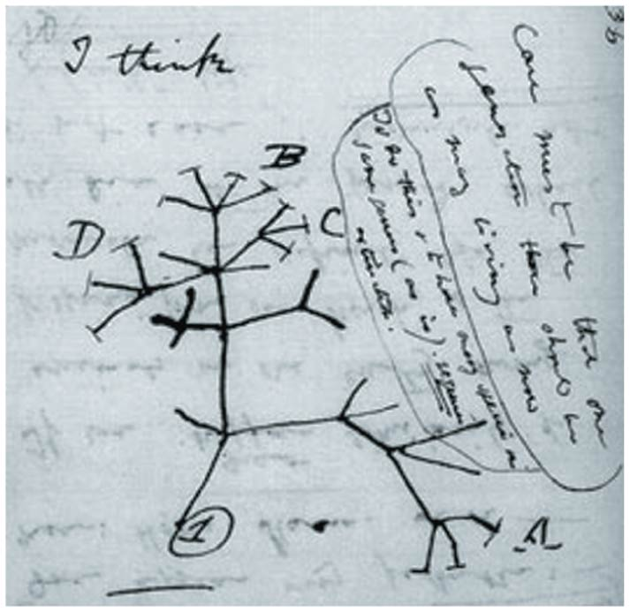
Missing Darwin notebooks returned to Cambridge University Library
Notes:
Figure 22.7 “I think. . . .” In this 1837 sketch, Darwin envisioned the branching pattern of evolution.

Slide 18
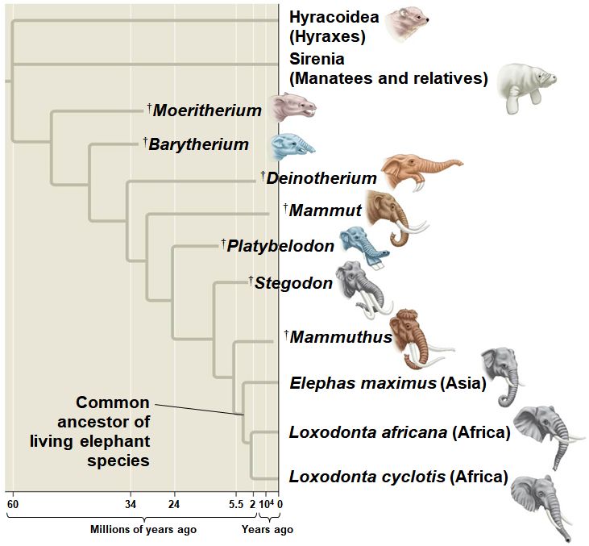
Figure 22.8
Notes:
Figure 22.8 Descent with modification

Slide 19
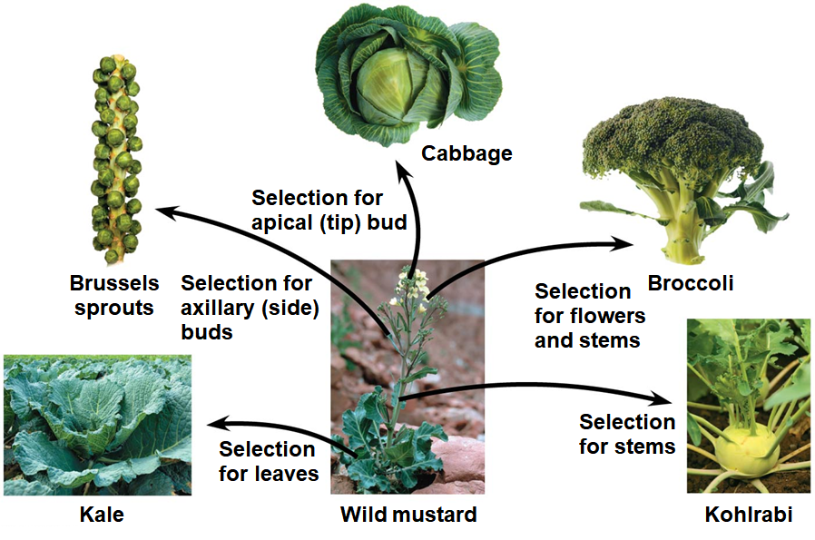
Artificial Selection, Natural Selection, and Adaptation
Darwin noted that humans have modified other species by selecting and breeding individuals with desired traits, a
Notes:
Figure 22.9 Artificial selection

Slide 20
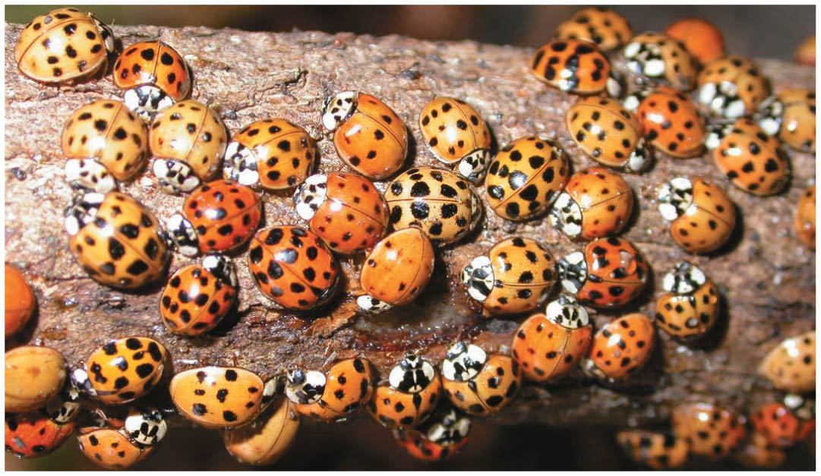
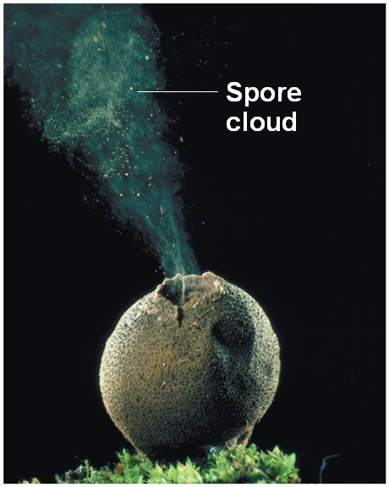
19
Darwin drew two inferences from two observations
Observation #1:
Observation #2: All species can produce more offspring than the environment can support, and
Notes:
Figure 22.10 Variation in a population
Figure 22.11 Overproduction of offspring

Slide 21
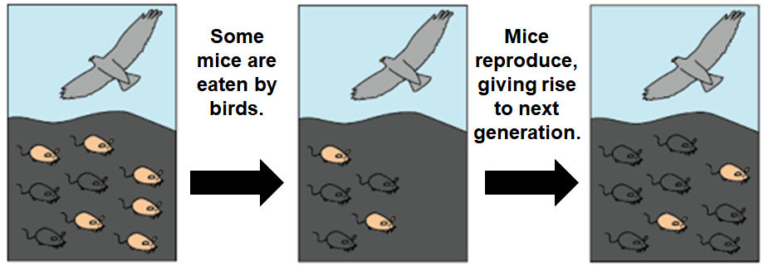
20
Inference #1: Individuals whose inherited traits give them a higher probability of surviving and reproducing in a given environment tend to
Inference #2: This unequal ability of individuals to survive and reproduce will lead to the accumulation of

Slide 22
21
Darwin was influenced by Thomas Malthus, who noted the potential for the human population to increase faster than
World Population now???
If some heritable traits are advantageous, individuals with these traits will produce more offspring that survive to reproduce, and this will increase the frequency of
This process increases the frequency of individuals with favorable adaptations and explains how organisms become increasingly well

Slide 23
Key Features of Natural Selection
Individuals with certain heritable traits survive and reproduce at
Natural selection increases the frequency of adaptations that are
If an environment changes over time, natural selection may result in adaptation to these new conditions and may
Note that individuals do
Natural selection can only increase or decrease
Adaptations

Slide 24
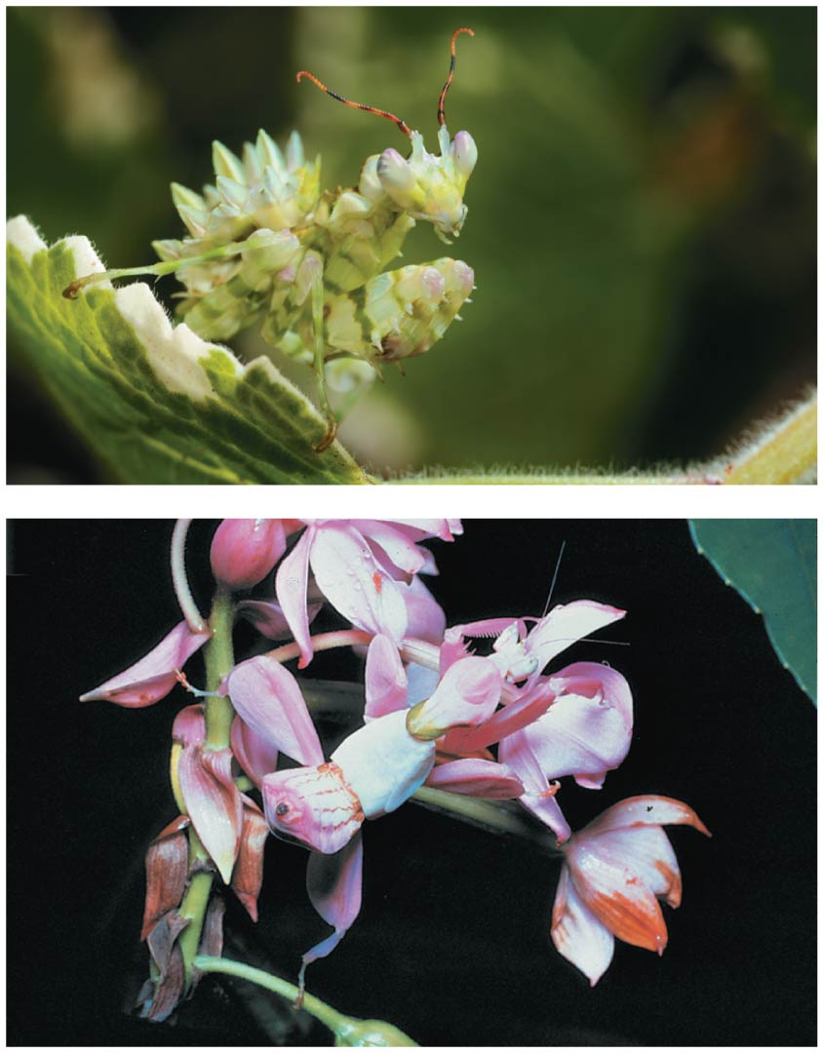
Figure 22.12
Praying
mantis
insects
Notes:
Figure 22.12 Camouflage as an example of evolutionary adaptation

Slide 25
Concept 22.3: Evolution is supported by an overwhelming amount of scientific evidence
New discoveries continue to fill the
Four types of data document the
Two examples provide evidence for natural selection: natural selection in response to introduced species and the

Slide 26
Natural Selection in Response to Introduced Species
Soapberry bugs use their “beak” to
Feeding is most effective when beak length is closely matched to
In southern Florida, they feed on the native balloon vine with larger fruit; they have
In central Florida, they feed on the introduced goldenrain tree with smaller fruit; they have

Slide 27
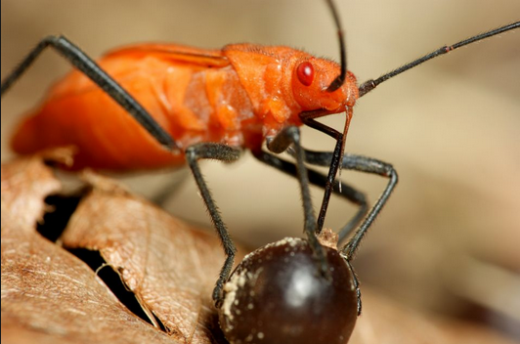
26
In all cases, beak size has evolved in populations that feed on introduced plants with fruits that are
These cases are examples of
In Florida, this evolution in beak size occurred

Slide 28
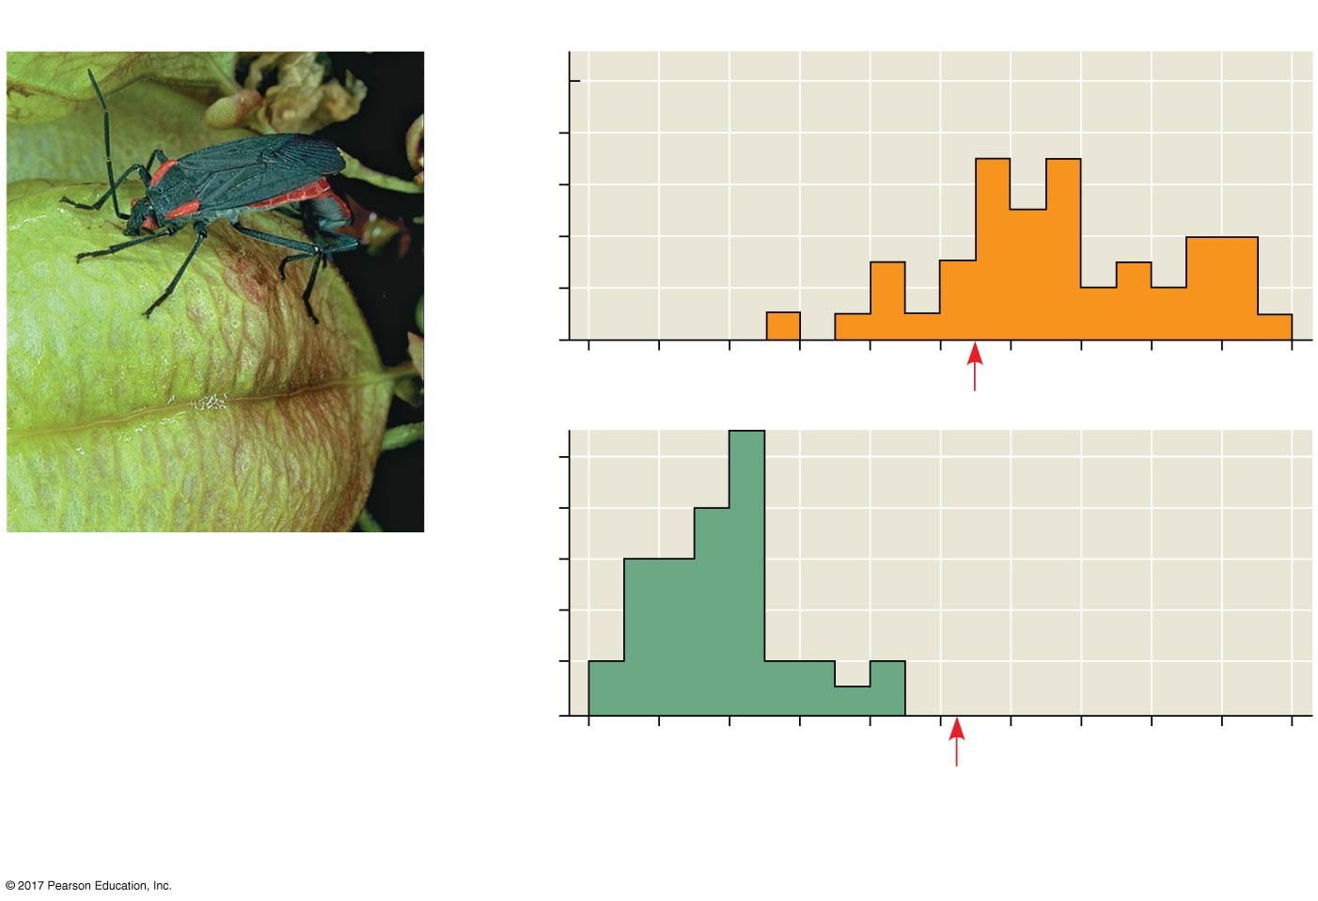
Figure 22.13
Field Study
Results
10
On native species,
balloon vine
(southern Florida)
8
6
Number of individuals
4
2
0
10
On introduced
species,
goldenrain tree
(central Florida)
Average
beak
lengths
in museum
specimens
8
Soapberry bug with beak
inserted in balloon vine
fruit
6
4
2
0
6
7
8
9
10
11
Beak length (mm)
Data from S. P. Carroll and C. Boyd, Host race radiation in the soapberry
bug: natural history with the history, Evolution 46:1052–1069 (1992).
Notes:
Figure 22.13 Inquiry: Can a change in a population’s food source result in evolution by natural selection?

Slide 29
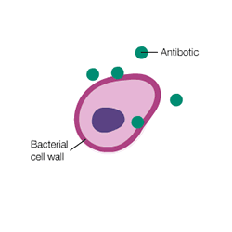
The Evolution of Drug-Resistant Bacteria
The bacterium Staphylococcus aureus is
One strain,
Resistance to penicillin evolved in S. aureus by
Resistance to methicillin evolved in S. aureus by 1961,
General mechanism in which antibiotics work

Slide 30
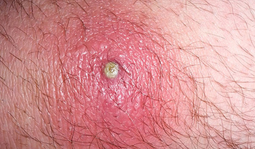
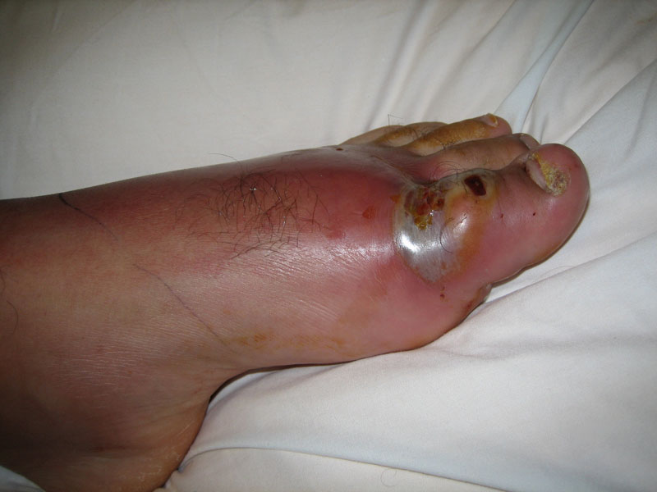
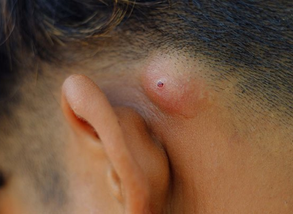
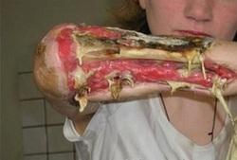
29
MRSA INFECTIONS

Slide 31
30
Methicillin works by inhibiting an
MRSA bacteria use a different enzyme in
When exposed to methicillin, MRSA strains are more likely to survive and
MRSA strains are now
In recent decades, antibiotic resistance has spread faster than
A new antibiotic, “teixobactin,” was discovered in 2015 and shows

Slide 32
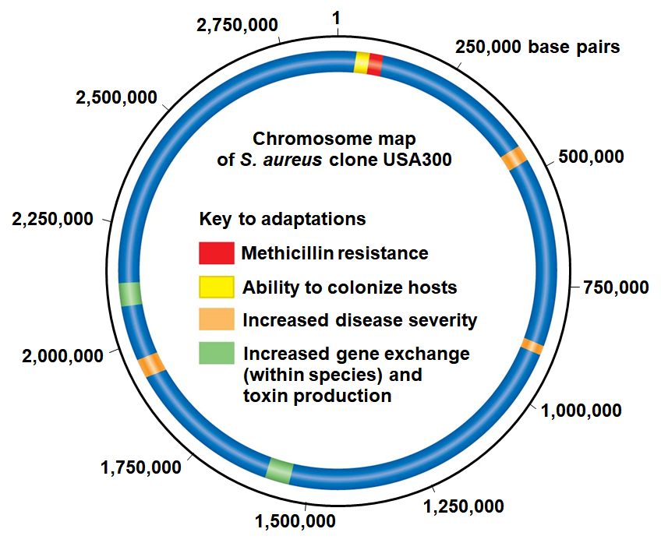
Figure 22.14
Notes:
Figure 22.14 Clone USA300: a virulent strain of methicillin-resistant Staphylococcus aureus (MRSA)

Slide 33
32
Natural selection does not create new traits, but edits or selects for traits
Evolution by natural selection can occur rapidly in species with
The current, local environment determines which traits will be selected for or selected
Individuals do not evolve, it is
Evolution relies on mutations, or
Mutations can be single nucleotides all the way through

Slide 34
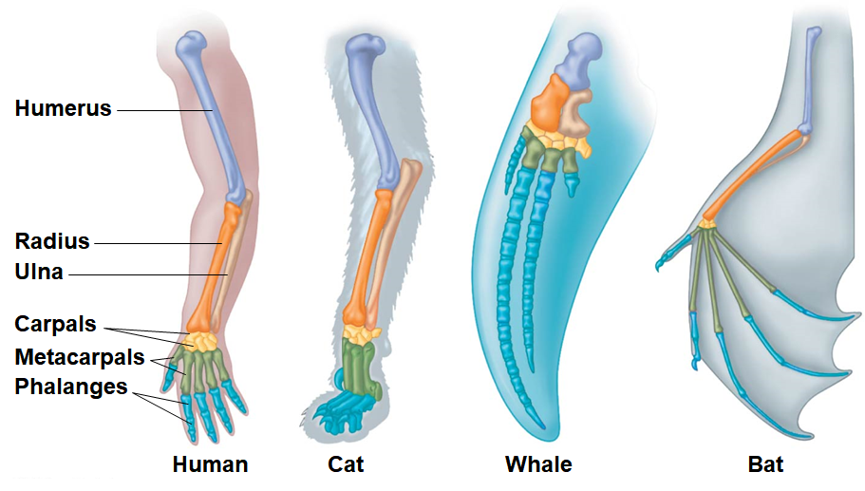
Anatomical and Molecular Homologies
Homology is
Homologous structures are anatomical resemblances that represent
Notes:
Figure 22.15 Mammalian forelimbs: homologous structures

Slide 35
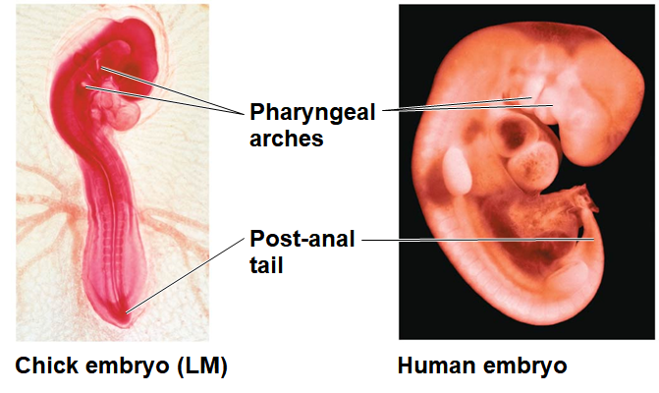
34
Comparative embryology reveals anatomical homologies
  EX: All vertebrate embryos have
Notes:
Figure 22.16 Anatomical similarities in vertebrate embryos

Slide 36
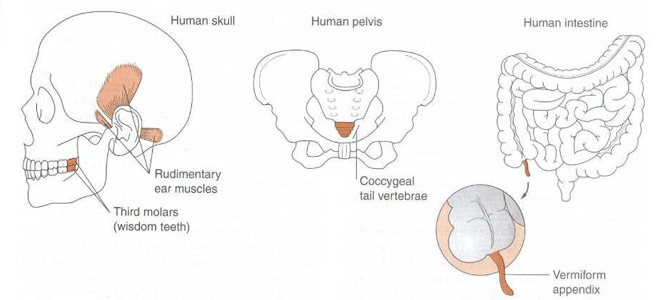
35
Vestigial structures are remnants of features that served
Examples of homologies at the molecular level are genes shared among

Slide 37
Homologies and “Tree Thinking”
Evolutionary trees are diagrams that reflect hypotheses about
Homologies form
Evolutionary trees can be made using different types of data, for example,

Slide 38
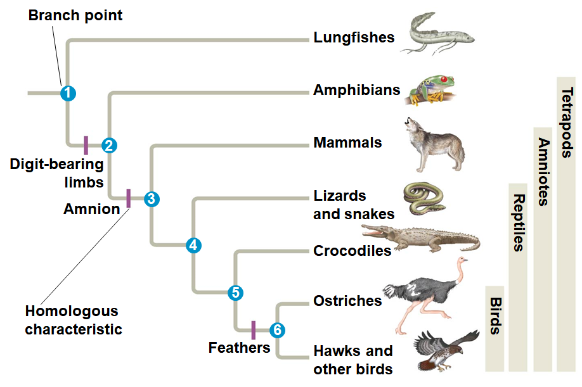
Figure 22.17
Notes:
Figure 22.17 Tree thinking: information provided in an evolutionary tree

Slide 39
A Different Cause of Resemblance: Convergent Evolution
Convergent evolution is the evolution of similar, or analogous,
Analogous traits arise when groups independently adapt to
Convergent evolution does

Slide 40
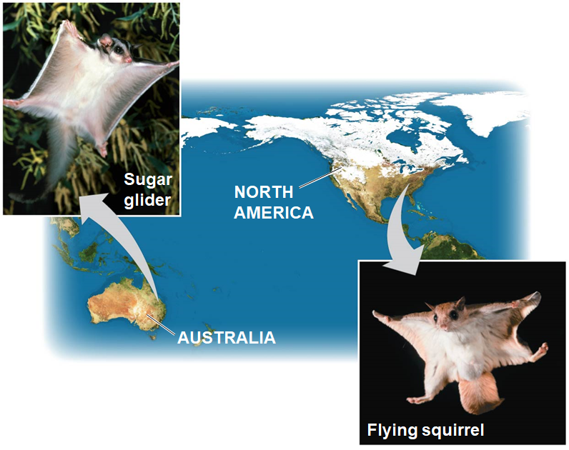
Figure 22.18
Notes:
Figure 22.18 Convergent evolution

Slide 41
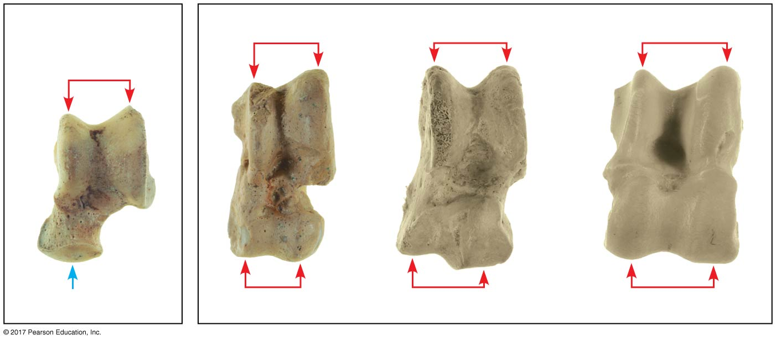
The Fossil Record
The fossil record provides evidence of the extinction of species, the origin of
Most mammals
Cetaceans and even-toed ungulates
(a) Canis (dog)
(b) Pakicetus
(c) Sus (pig)
(d) Odocoileus (deer)
Notes:
Figure 22.19 Ankle bones: one piece of the puzzle

Slide 42
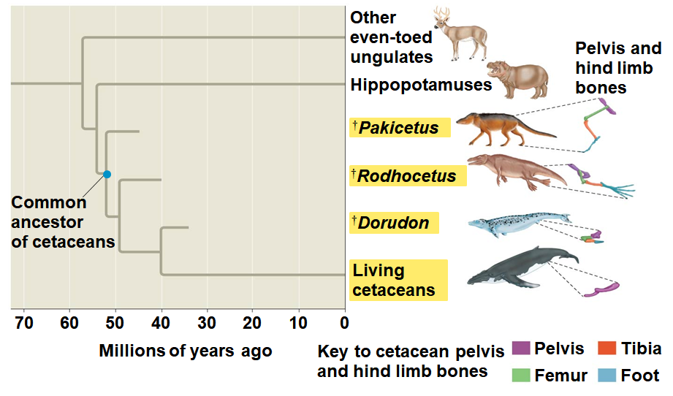
41
Fossils can document important
  EX: The transition from
Notes:
Figure 22.20 The transition to life in the sea

Slide 43
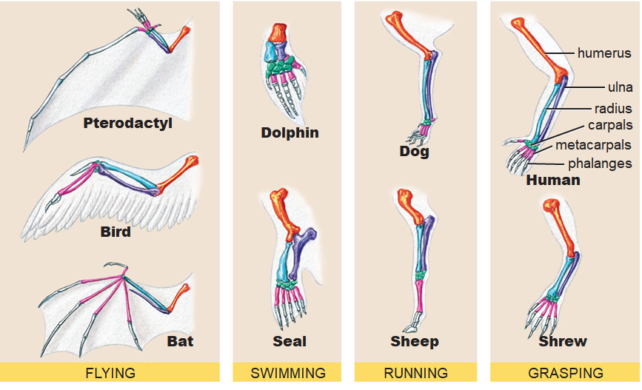
Homologous Structures
***Similar anatomy/structure, but different uses***

Slide 44
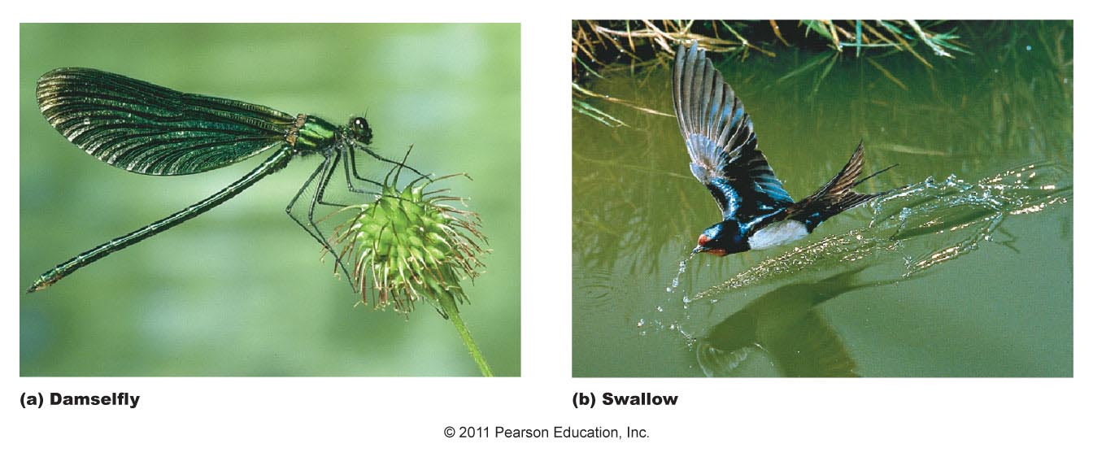
Analogous Structures
***Different anatomy/structure, but similar uses***

Slide 45
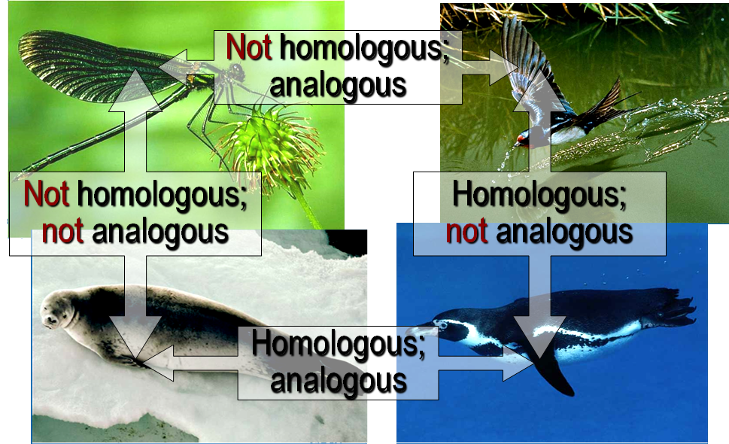
Analogous & Homologous Structures
0

Slide 46
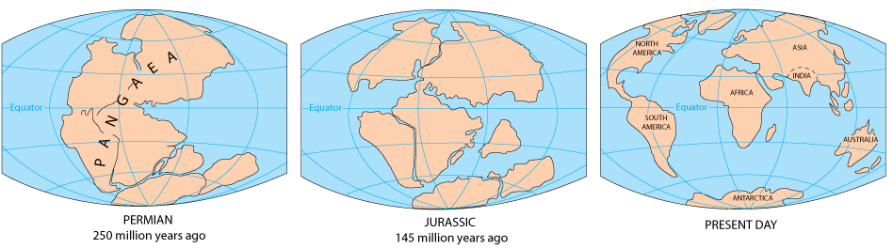
Biogeography
Biogeography, the scientific study of the geographic distribution of
Earth’s continents were formerly united in a single large continent called
An understanding of continent movement and modern distribution of species allows us to

Slide 47
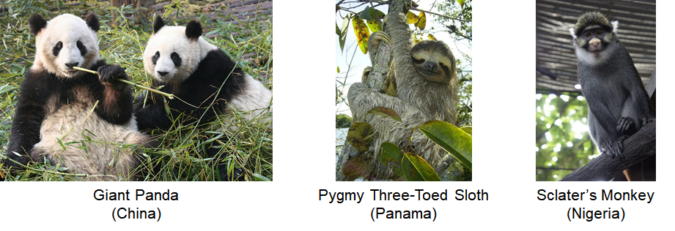
46
Endemic species are species that are
Islands have many endemic species that are often closely related to
Darwin suggested that species from the mainland colonized islands and gave rise to

